Slide 1
Natural Language Processing (NLP)
DePaul IPD Program Lecture Course

Slide 2
What is NLP?
Using machines to understand natural language
Extract features from text to input to machine learning algorithms
E.g. Google

Slide 3
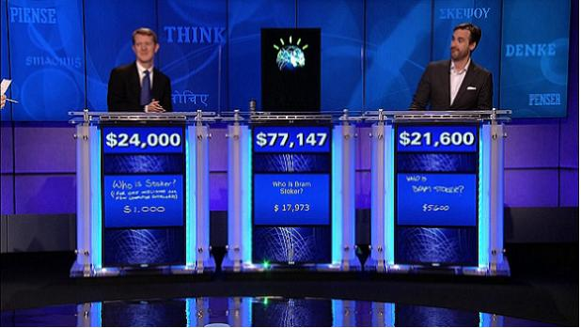
What’s This?

Slide 4
Examples – Question Answering
Problem: Given a question posed in a natural language (e.g. English) provide an appropriate answer
Watson – Won Jeopardy on February 16th 2011
William Wilkinson’s ”An Account of the Principalities Wallachia and Moldovia” inspired this author’s most famous novel
Bram Stoker (Dracula)

Slide 5
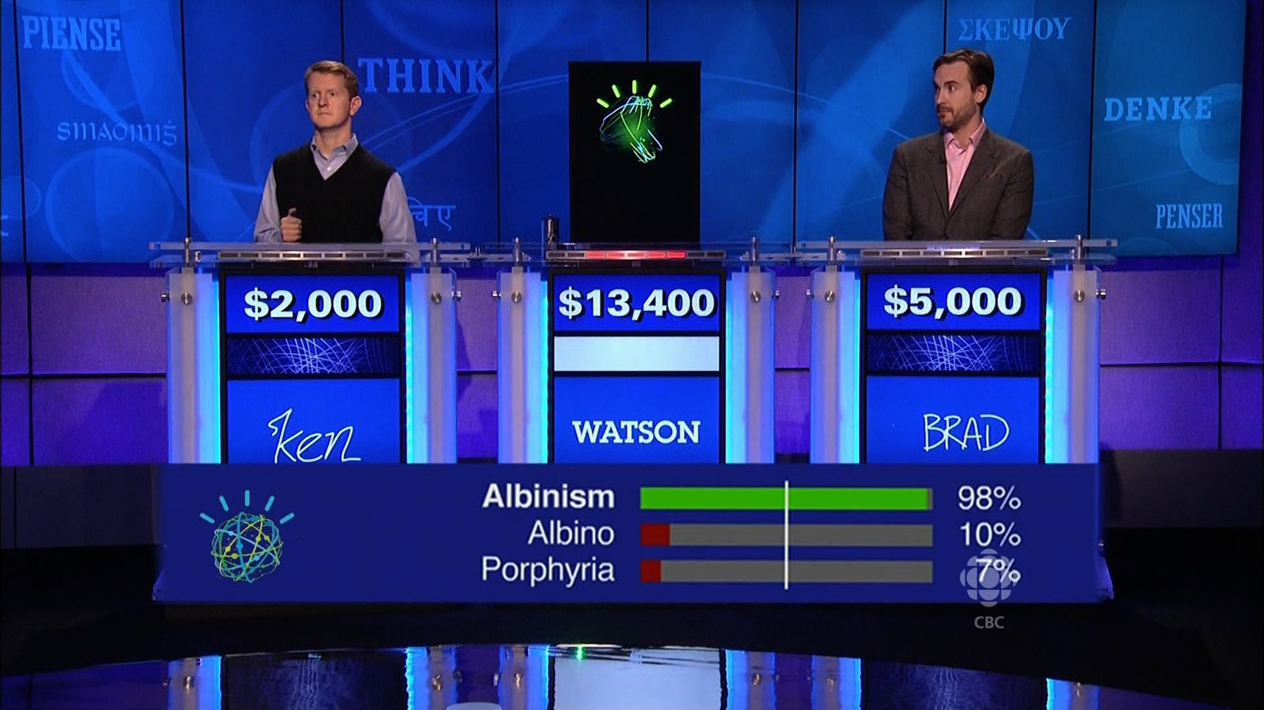
IBM Watson – Computes Confidence over many Possible Answers

Slide 6

Search
Information retrieval is an important NLP problem
All major search engines leverage a number of common NLP techniques, along with some complex machine learning

Slide 7
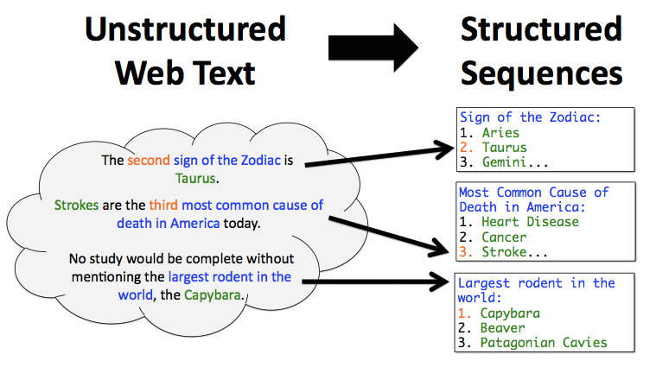
Information Extraction
Extracting structured information from unstructured data (text)
E.g. filling out parts of a product catalog from text
Notes:
From http://ai.cs.washington.edu/projects/open-information-extraction last accessed 11/09/2014

Slide 8
Text Summarization
http://www.tools4noobs.com/summarize/
Take a news article, book, financial report, etc, and produce a concise summary of the article
Very hard problem
Dice’s currently working on a variant of this problem
E.g. Summly IOS app
Long news articles are difficult to read on a small smart phone screen
Often users don’t want or have the time to read a full article
Summly was developed by a 16 year old Brit to summarize news articles for smart phone consumption
As of march 2013, Summly was sold by it’s then 18 year old owner to Yahoo for $30,000,000!
Notes:
Source: https://en.wikipedia.org/wiki/Nick_D%27Aloisio#Summly last accessed 11/09/2014
Source: http://www.stuff.co.nz/technology/digital-living/8474218/Teens-multi-million-dollar-Yahoo-payday last accessed 11/09/2014

Slide 9
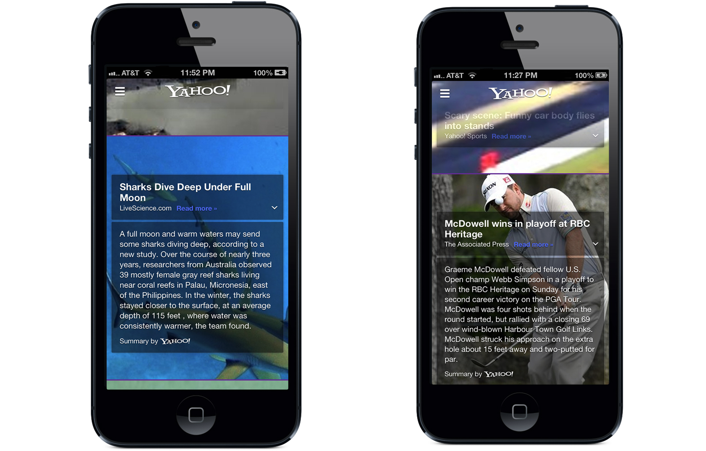
Yahoo - Summly
Notes:
From http://www.cnet.com/news/yahoo-brings-summly-to-iphone-app/, last accessed 11/09/2014

Slide 10
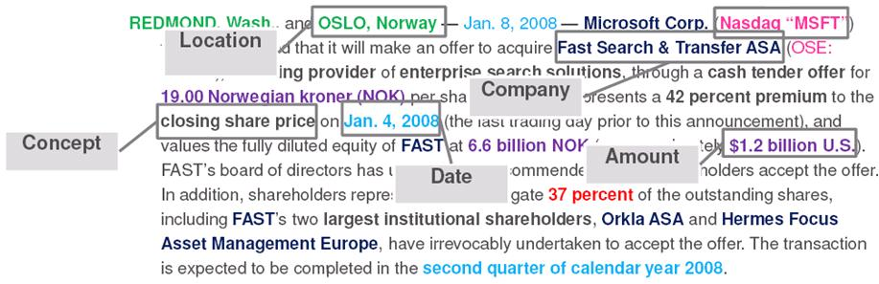
Named Entity Recognition
Extracting named entities from text, such as the names of people, companies, locations, expressions of time, quantities, monetary values, percentages, etc
Notes:
From http://searchmatics.wordpress.com/page/2/, last accessed 11/09/2014

Slide 11
Sentiment Analysis
Automatically determine whether text is written in a positive, negative or neutral manner
Can be a very hard problem due to negations (not, doesn’t, etc) and antonyms can throw off automatic systems
E.g. determining if online product reviews are positive or negative
E.g. determining whether the stock market sentiment is positive or negative based on the content of various news articles
This has caused the ‘Anne Hathaway’ affect
For a time, every time an Anne Hathaway movie came out, Berkshire Hathway’s stock price was affected, based on the sentiment of the movie reviews!
>>> A Named Entity resolution problem!

Slide 12
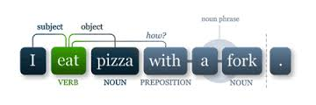
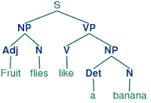
Natural Language Parsing
POS Tagging
Notes:
Serve as inputs to other NLP tasks, such as sentiment analysis, NER, text classification, etc

Slide 13
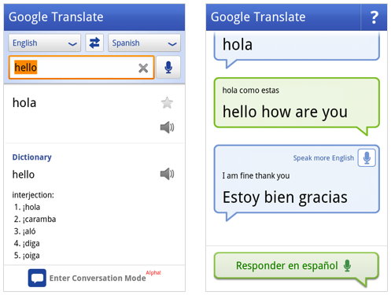
Machine Translation
Notes:
From http://googleblog.blogspot.com/2011/01/new-look-for-google-translate-for.html, last accessed 11/09/2014

Slide 14
Word Sense Disambiguation
A single word can have many different meanings or senses
Determining which is referred to in a sentence is an open problem (can be partially solved)
E.g. mouse – a device and an animal
E.g. bass – a fish, and also a set of low tones in music
E.g. fire – something that’s burning, to fire is to give the sack
E.g. pickle – as in dill pickle, or someone’s in a pickle

Slide 15
Why is NLP so Dang Hard?
Synonymy – many words, same meaning
Polysemy – one word, many meanings (word sense disambiguation deals with this)
Multi-lingua – wide variety of natural languages in the world
Homophones in speech – e.g. free and three, carrot and caret, two and too, etc
Spelling errors in text
Text segmentation – languages like Chinese and Japanese don’t have natural word or sentence boundaries.
Idioms – ‘Bob’s your uncle’, ‘Too many cooks in the kitchen’, ‘A chip on your sholder’ – particularly problematic for machine translation
Natural language understanding is AI Complete

Slide 16
Ambiguity
Last night I shot an elephant wearing my pajamas
They are hunting dogs
We saw her duck
Turn right here…
Police help dog bite victim
Book stays in London
The girl in the car that needed water is waiting
Flying planes can be dangerous
Notes:
List taken from http://en.wikipedia.org/wiki/List_of_linguistic_example_sentences, last accessed 11/09/2014

Slide 17
Basic Text Processing
To prepare text for input into a machine learning or NLP system, the following steps are usually taken:
Removal of stop words (the, at, and, etc)
Frequent words that don’t add information about content
Removal of infrequent terms
Often below 5 or 10 occurrences in the whole corpus
Dramaticall reduces number of unique terms
Stemming or Lemmatization – extract the root of a word
Spelling correction – use an automatic spelling corrector
Case folding
If case is not important to the task, make all text either upper or lower case

Slide 18
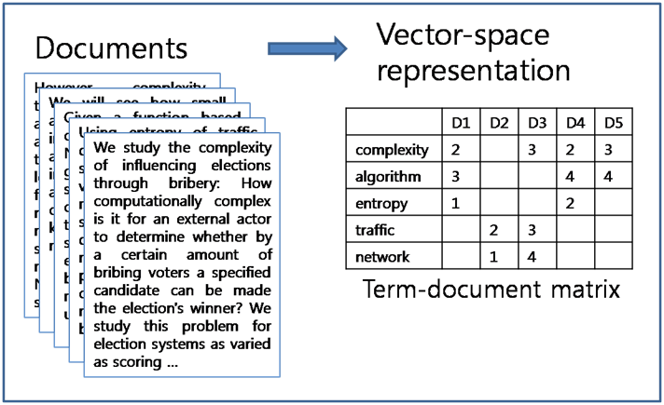
Vector Space Model
Notes:
From http://mlg.postech.ac.kr/research/nmf, last accessed 11/10/2014

Slide 19
The Vector Space Model
Very critical to developing NLP applications
Each document forms a column in a matrix
Each unique term forms a row
Each cell contains the number of instances of that term in a particular document – “Term-Document Matrix”
Also called a “Bag of Words” model – as word order is lost
Forms the basis of search engines

Slide 20
Term Frequency – Inverse Document Frequency
Often cells in a term document matrix are weighted by their Tf.Idf score
Very popular weighting scheme used commonly in a lot of NLP tasks and in search engines
Tf = Term Frequency of a term in a document
Idf = Inverse document frequency
= (Number of docs) / (Number of documents with that term)
Often the Tf and Idf values are logged – reduces relative effects of high frequencies, and makes the distribution closer to a normal distribution

Slide 21
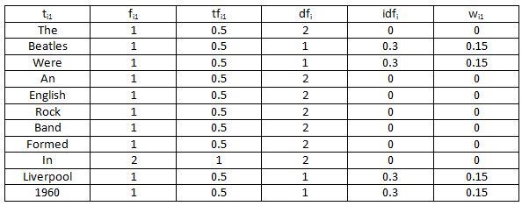
Term Frequency – Inverse Document Frequency

Slide 22
Information Retrieval
The science of search
Search engines use a version of the term document matrix to store documents, called an inverted index
Words map to indices of the documents that contain them
Allows fast retrieval of matching documents without scanning all possible documents
A query from the user is transformed in a column vector of the term document matrix
The most similar documents are retrieved based on cosine similarity
Very similar to the k-nearest neighbor algorithm

Slide 23
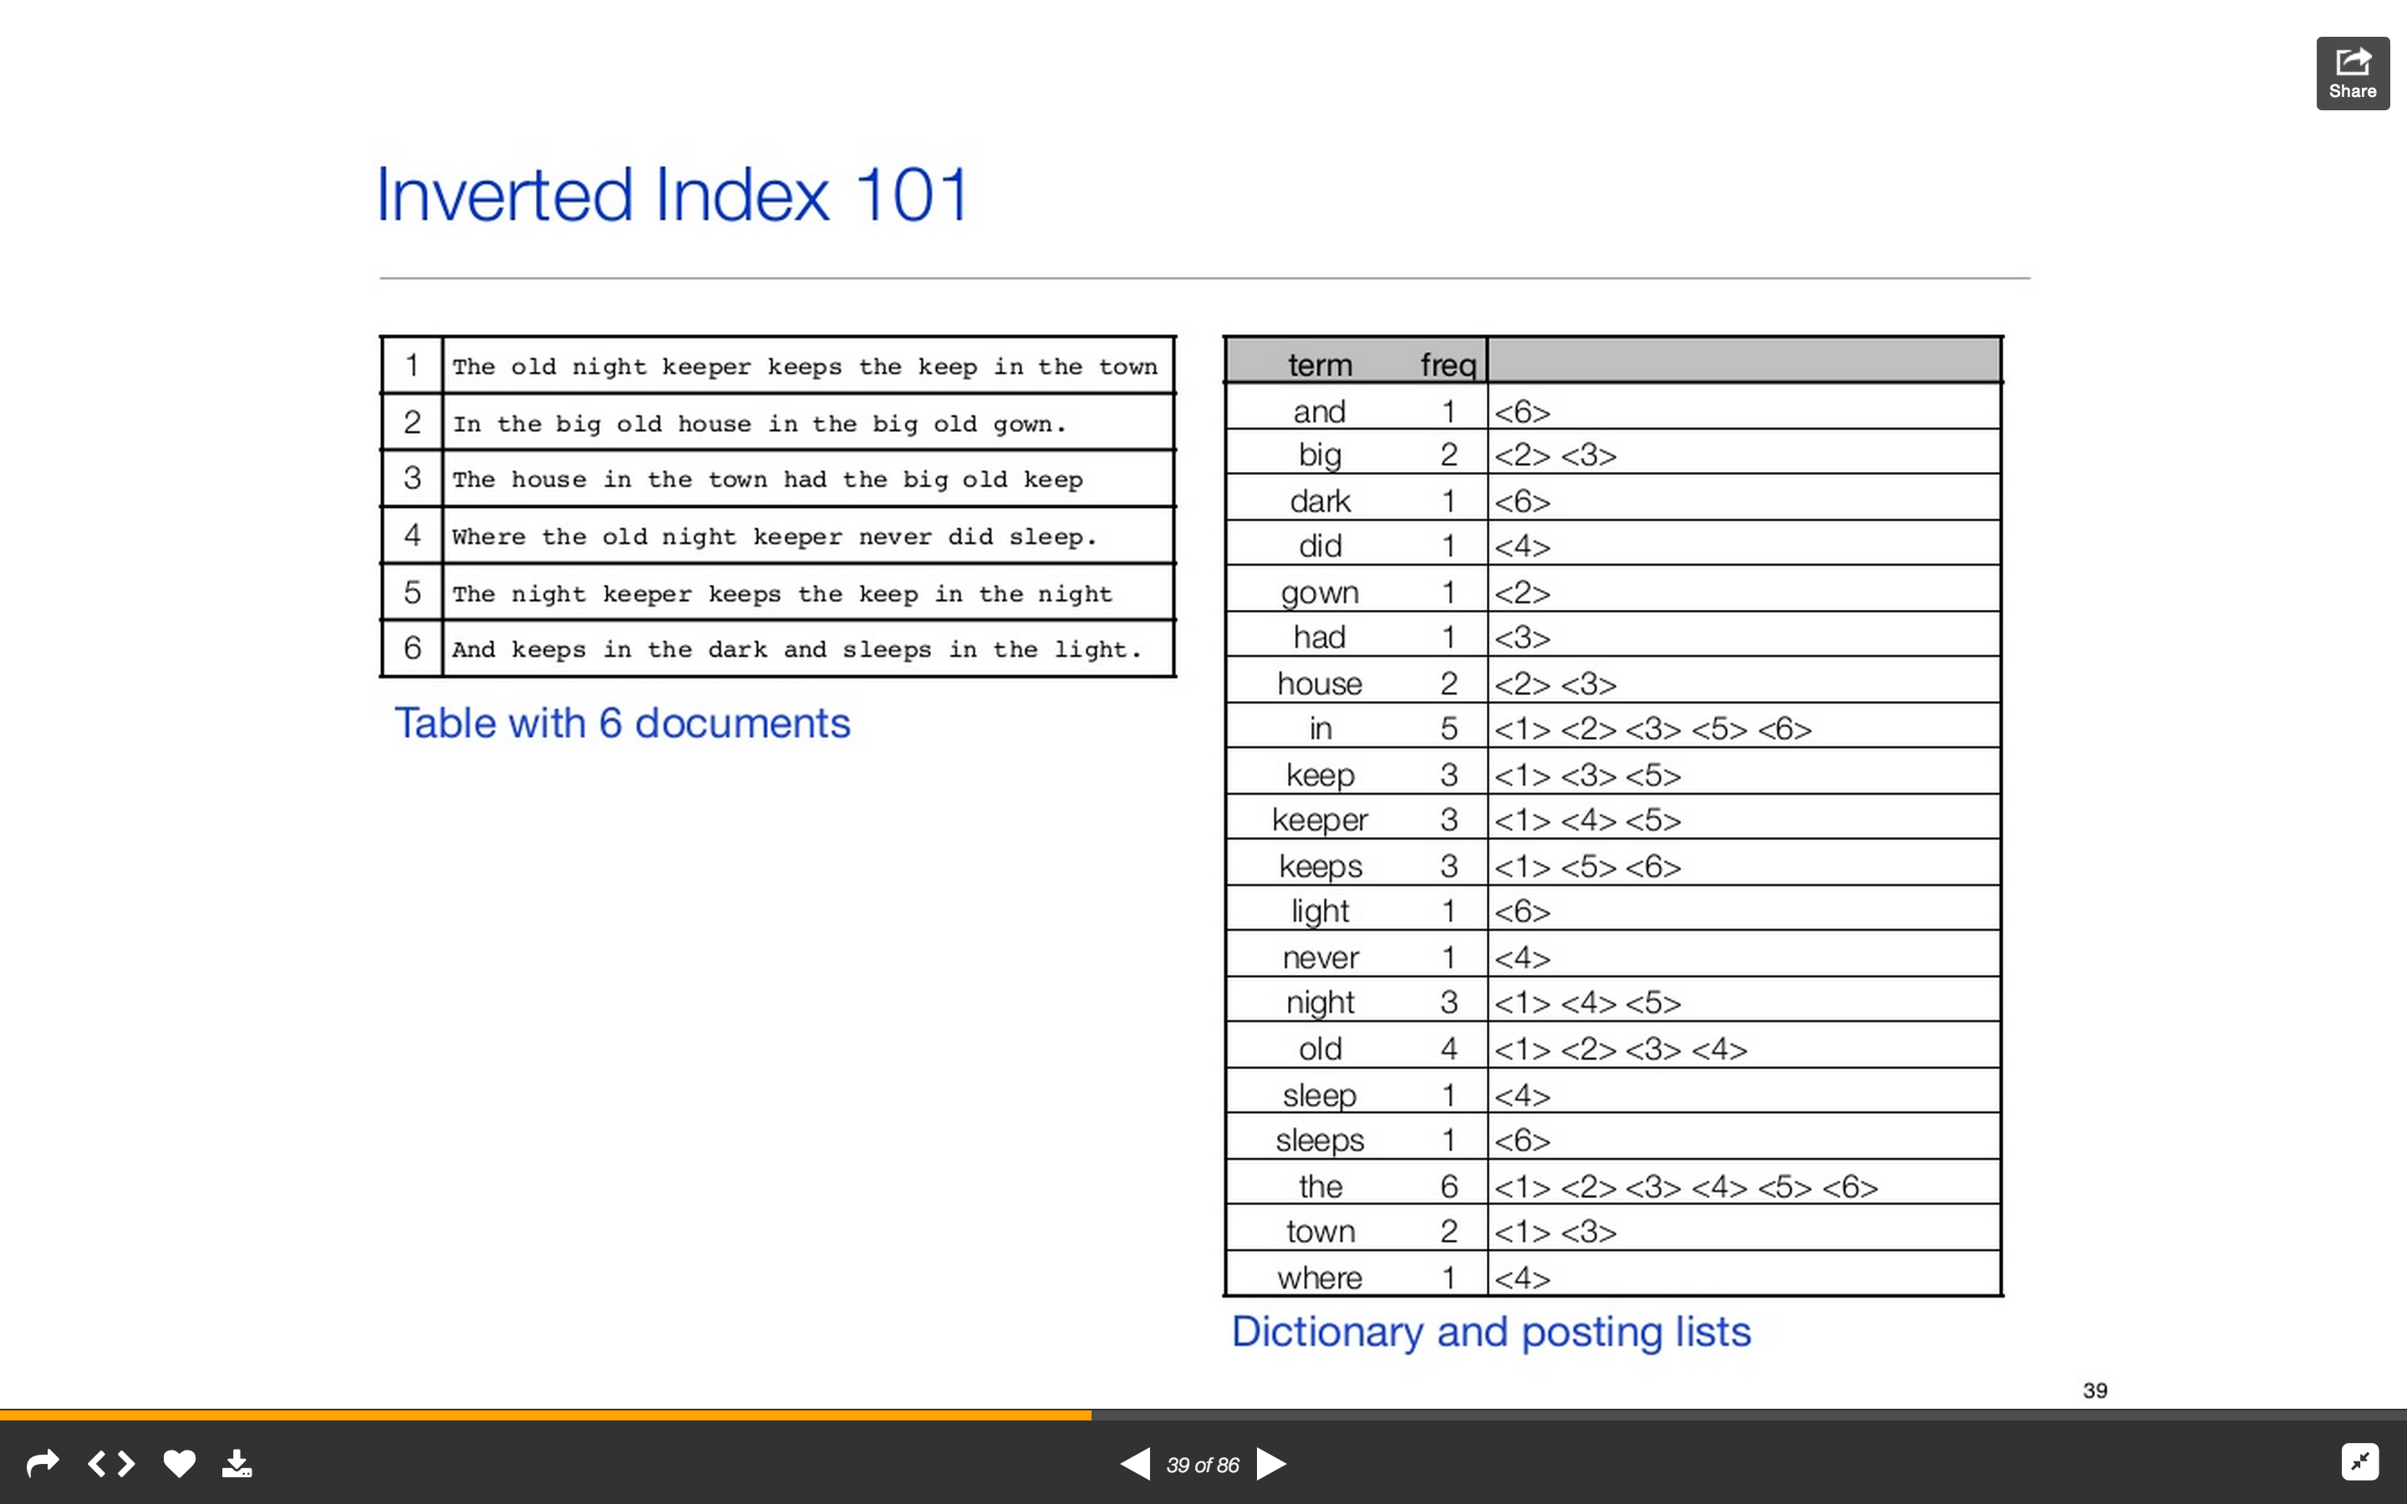
Inverted Index 101
Notes:
From http://www.slideshare.net/lucenerevolution/twitter-search-lucenerevolutioneu2013-copy?next_slideshow=1, slide 39. Last accessed 11/13/2014

Slide 24
Advantages of the Vector Space Model
Same number of columns regardless of the document length – easy to feed to a machine learning algorithm
Cosine metric allows short and long documents to be compared for similarity
Allows partial matching between documents
Disadvantages of the Vector Space Model
The ordering of words in the document is lost
Assumes independence between terms
Long documents have low similarities
Requires exact matches only on terms

Slide 25
LSA
Take the vector space model and use a form of dimensionality reduction to reduce the number of rows (terms) to a lower dimensional space
Automatically learns a notion of word relatedness – related words collapse to the same dimensions
Allows comparison of two documents for similarity even if they don’t share the same words
Has been shown to perform similarly to humans on word analogy problems (and makes a lot of the same mistakes)
http://lsa.colorado.edu/

